Slide 1
Length and Perimeter

Slide 2
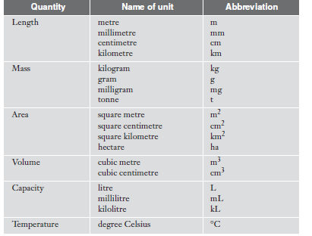

Slide 3
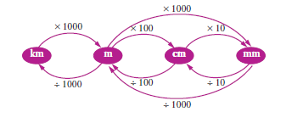

Slide 4
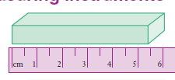
Measurements
All measurements are only approximations.
No measurement is ever exact.
Using a ruler with 0.5cm marking, We might measure this eraser to be 5.5 cm long.
If we used a more precise ruler, with 0.1 cm markings, then we find the length to be 5.4 cm.
If we used a micrometer that measured to the nearest 0.01 cm, we may find that the measured length is 5.41 cm.
All measurements are approximations.

Slide 5
Limit of Accuracy
The Limit of Accuracy of a Measuring Instrument are +/- 0.5 of the unit shown on the instrument’s scale

Slide 6
Perimeter
The Perimeter of a shape is the distance around the shape. It is the sum of the lengths of the sides of the shape

Slide 7
This powerpoint was kindly donated to
www.worldofteaching.com
http://www.worldofteaching.com
Is home to well over a thousand powerpoints submitted by teachers. This a free site. Please visit and I hope it will help in your teaching
Notes:
7

